Slide 1
Digital Portfolio
STUDENT NAME: RAJALAKSHMI P
REGISTER NO AND NMID: 212401024 / 2FB24698E7B2F6D97AC48840C4C659F4
DEPARTMENT: COMPUTER APPLICATIONS
COLLEGE: UNIVERSITY OF MADRAS

Slide 2
PROJECT TITLE DIGITAL PORTFOLIO USING FRONT END DEVELOPMENT

Slide 3


AGENDA
Problem Statement
Project Overview
End Users
Tools and Technologies
Portfolio design and Layout
Features and Functionality
Results and Screenshots
Conclusion
Github Link
3/21/2024 Annual Review

Slide 4

PROBLEM STATEMENT
In today's rapidly evolving world, many students, especially from rural and underprivileged backgrounds, face significant challenges in accessing quality education, skill development, and career guidance. Despite having potential, a lack of awareness about emerging technologies and industries often limits their opportunities for growth and employment. Moreover, the gap between academic learning and industry requirements continues to widen, making it difficult for graduates to become job-ready. This calls for a need to develop innovative, technology-driven solutions that bridge the skill gap, provide personalized learning paths, and offer career guidance based on individual aptitude and market trends. By addressing these issues through platforms like Naan Mudhalvan, we can empower youth with the right skills, improve employability, and contribute to the socio-economic development of the state.

Slide 5

PROJECT OVERVIEW
The project aims to [insert primary objective—e.g., develop a web-based platform, improve operational efficiency, launch a new product, etc.], addressing the need for [mention the core problem or opportunity]. It involves [briefly describe the scope—e.g., multiple departments, specific technologies, target audiences, etc.] and is scheduled to run from [start date] to [end date]. Key stakeholders include [list major contributors or teams], all working collaboratively to ensure successful delivery. The project is expected to result in [mention key outcomes—e.g., improved user experience, increased sales, streamlined processes], and is currently [status—e.g., in progress, on track, etc.].

Slide 6

WHO ARE THE END USERS?
The Naan Mudhalvan scheme is designed to impact a wide range of stakeholders. The primary end users are students across Tamil Nadu, especially those pursuing undergraduate and postgraduate programs. They benefit from skill development courses, industry-relevant training, aptitude building, and career guidance, which prepare them for employment and entrepreneurship opportunities.
The next important end users are educational institutions, including colleges, universities, and training centers. By integrating the Naan Mudhalvan platform, institutions can provide their students with structured training modules, certifications, and access to career resources.

Slide 7

TOOLS AND TECHNIQUES
The scheme makes use of modern digital technologies, training methods, and interactive learning practices to bridge the gap between academics and employability. At the core, the initiative relies on an online learning management system (LMS), which acts as a central hub where students can explore courses, attend virtual classes, and monitor their progress. This digital-first approach ensures accessibility to every student across Tamil Nadu, regardless of location.

Slide 8
POTFOLIO DESIGN AND LAYOUT
A portfolio should be designed in a clean, structured, and user-friendly layout so that visitors can easily navigate and understand your skills and achievements. The design usually begins with a homepage or landing section, where your name, professional title, and a short tagline are highlighted, creating a strong first impression.
The layout then flows into an About Me section, giving a brief introduction, background, and career goals, often with an option to download the resume. Following this, a Skills section is included to display both technical and soft skills. These can be represented visually using icons, progress bars, or categorized lists to make the section engaging.
8

Slide 9
FEATURES AND FUNCTIONALITY
The portfolio website is designed with multiple features and functionalities that make it professional, user-friendly, and effective for showcasing personal skills and achievements. The homepage acts as the first point of interaction, displaying the individual’s name, professional title, and a clear navigation menu that guides visitors through the website. The About Me section provides a short introduction, career objectives, and a link to download the resume, helping recruiters quickly understand the candidate’s background. The Skills section highlights both technical expertise, such as programming languages and tools, and soft skills like teamwork and communication, often represented with icons or visual progress indicators for better readability. A dedicated Projects section showcases major academic and personal works with titles, descriptions, technologies used, screenshots, and GitHub or live demo links, allowing employers to see proof of work in action.

Slide 10
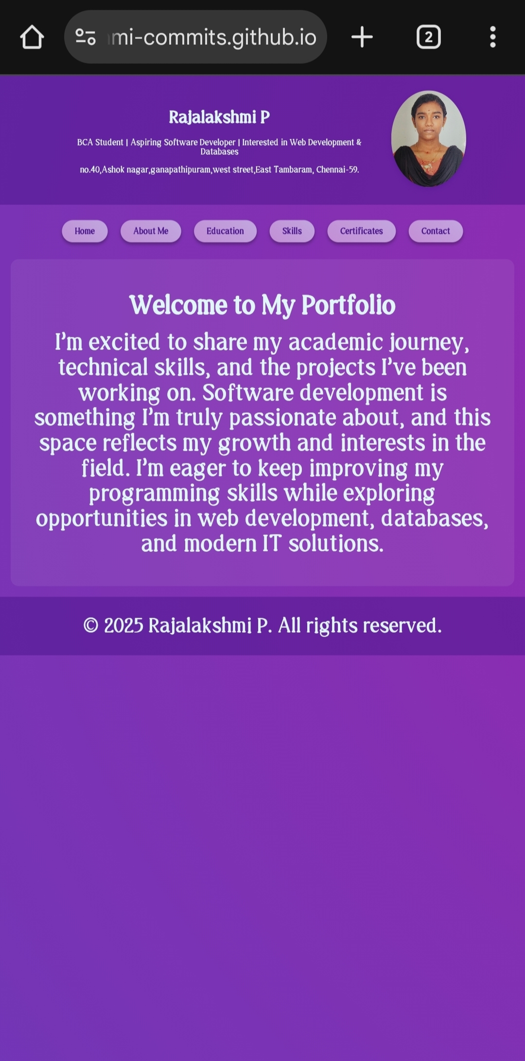

RESULTS AND SCREENSHOTS
The portfolio website was successfully designed and developed with a clean, responsive, and user-friendly interface. All the planned features such as Homepage, About, Skills, Projects, Certifications, and Contact sections were implemented effectively. The website allows smooth navigation, works seamlessly on desktop and mobile devices, and provides recruiters with easy access to the candidate’s information and project showcases. The inclusion of live project links, GitHub repositories, and downloadable resumes has enhanced the portfolio’s professional value. Overall, the project achieved its objective of creating a personal branding platform that highlights skills, achievements, and career aspirations.
3/21/2024 Annual Review
10

Slide 11
CONCLUSION
The portfolio website project successfully achieved its objective of creating a professional and user-friendly platform to showcase personal skills, projects, and achievements. By incorporating a clean design, responsive layout, and smooth navigation, the portfolio provides recruiters, collaborators, and academic mentors with easy access to relevant information. The integration of sections such as About Me, Skills, Projects, Certifications, and Contact ensures that the portfolio is both comprehensive and engaging.
11

